Slide 1
Spring Framework Essential
Dang Thi Thao My

Slide 2
Introduction
History
Documentation Reference

Slide 3
Overview
Writing Components that deploy inside Containers. The Containers provide interface to allow Service Provider to provide Services.
Components: Jar, war, ear
Containers: web, ejb
Services: security, transactional, persistence, resource pooling
Lightweight container: provide services to POJOs

Slide 4
Overview
Inversion of Control
Container (IoC)
Injecting Dependencies
A dependency is imply an attribute, a method argument, return type.
Injection – calling a setter method, or using a constructor argument.
Metadata describes the actual classes and services that we want.
Spring wires everything together and manages the lifecycle.

Slide 5
Overview
We rarely instantiate beans
We don’t look them up
Tools
Spring Tool Suite (Eclipse Public License, a business-friendly free software license)
IntelliJ IDEA (Commercial)

Slide 6
History
Spring 1.0 – 2004
Spring 2.0 – 2006: simplified XML config
Spring 2.5 – 2007: annotation configuration
Spring 3.0 – 2010 to 2012
Spring 3.2 – 2012
Support for Java 7, Hibernate 4, Servlet 3.0
Required Java 1.5+
Java configuration approach
Spring 4.0 – 2014
Supports Java 8
Spring Boot – 2014
Spring 4.3.3 – 2016 (Latest)

Slide 7
Reference Documentation
Reference:
http://docs.spring.io/spring/docs/current/spring-framework-reference/htmlsingle/
API:
http://docs.spring.io/spring/docs/current/spring-framework-reference/htmlsingle/
Spring favors interface/class separation
Write your code in terms of interfaces
Tell Spring which classes to provide
“wire everything together”

Slide 8
Building Application
A simple Java Application with Spring
Java-Based Configuration
Annotation Configuration
The Classic XML Approach

Slide 9
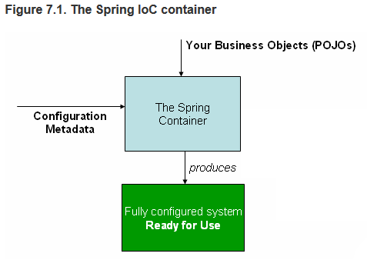
A simple Application
Maven handles Dependencies
Lib Beans

Slide 10
Glassfish Server
Install JDK
Download Glassfish
Unzip
Open bin folder in cmd and type:
asadmin start-domain
Access: localhost:4848

Slide 11
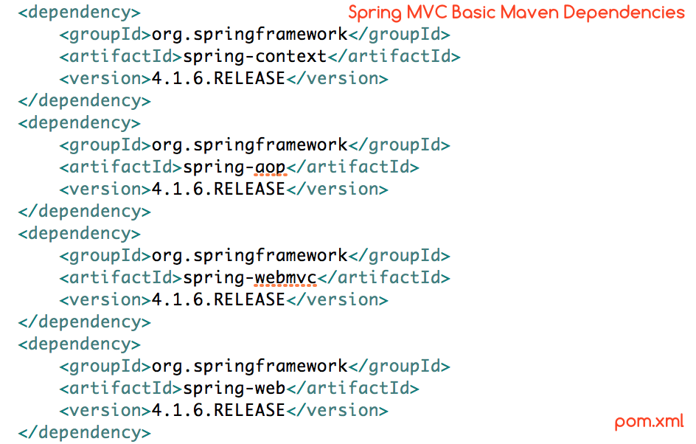
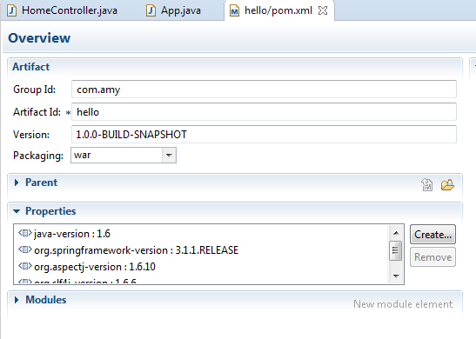
Maven – Dependency management
Site name (reversed)
Package name

Slide 12
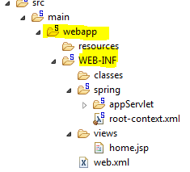
Folder structure

Slide 13
Questions and Answers

Slide 14
Thank you! =))

